Slide 1
Undirected Graphic Models

Slide 2
Intro to Undirected Graphs
A graph can be represented by 2 types of objects
Nodes (aka vertices)
Edges
The edges represent relationships between the nodes and can (but not necessarily) have weights to quantify the strengths of the relationships
Nodes can take on continuous or discrete values. We will cover both in this class
Another type of graph is a directed graph, which we will not cover
A Bayesian networks is a type of directed graph

Slide 3
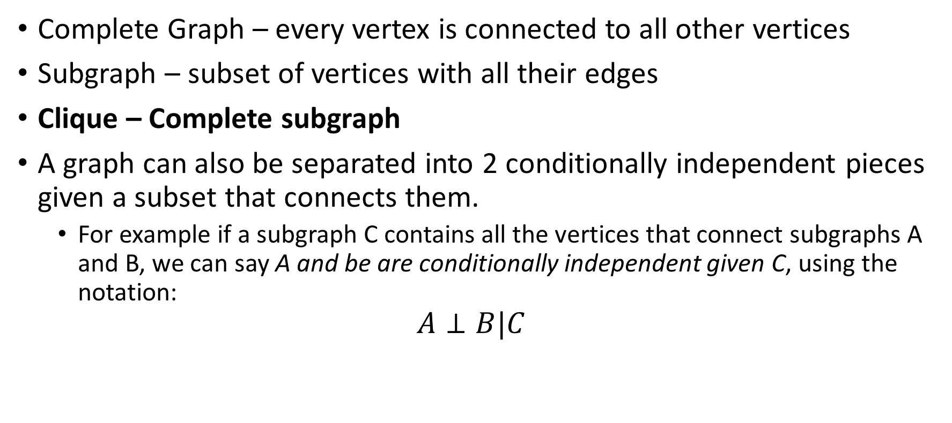
Cliques and Graphs Attributes
Complete Graph – every vertex is connected to all other vertices
Subgraph – subset of vertices with all their edges
Clique – Complete subgraph
A graph can also be separated into 2 conditionally independent pieces given a subset that connects them.
For example if a subgraph C contains all the vertices that connect subgraphs A and B, we can say A and be are conditionally independent given C, using the notation:
$$A⊥B|C$$
C
l
Note: many computations on graphs (which we will see) first compose a graph into its maximum cliques
A
X
B
n
m

Slide 4
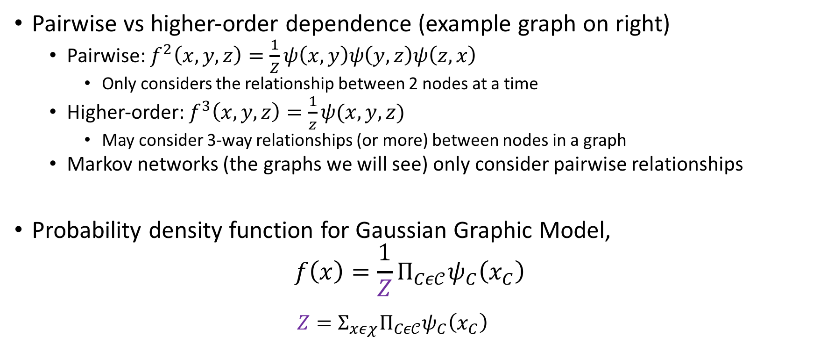
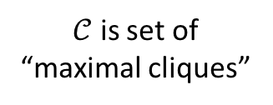
Graph Attributes continued
Pairwise vs higher-order dependence (example graph on right)
Pairwise: $f^{2}\left(x,y,z\right)=\frac{1}{Z}ψ\left(x,y\right)ψ\left(y,z\right)ψ\left(z,x\right)$
Only considers the relationship between 2 nodes at a time
Higher-order: $f^{3}\left(x,y,z\right)=\frac{1}{z}ψ(x,y,z)$
May consider 3-way relationships (or more) between nodes in a graph
Markov networks (the graphs we will see) only consider pairwise relationships
Probability density function for Gaussian Graphic Model,
$$f\left(x\right)=\frac{1}{Z}Π_{Cε𝒞}ψ_{C}\left(x_{C}\right)$$
$$Z=Σ_{xεχ}Π_{Cε𝒞}ψ_{C}\left(x_{C}\right)$$
X
Y
Z
Normalizing constant
Click potentials (+ve)
$𝒞$ is set of “maximal cliques”

Slide 5
Markov Graphs Intuition
In a Markov graph, the nodes are random variables and the edges are parameters measuring the relationship between variables
A graph is just a way to visualize the joint distribution of a group of random variables

Slide 6
Gaussian Graphic Models (aka “Markov Networks” or “Markov Random Fields”) – Continuous Variables

Slide 7
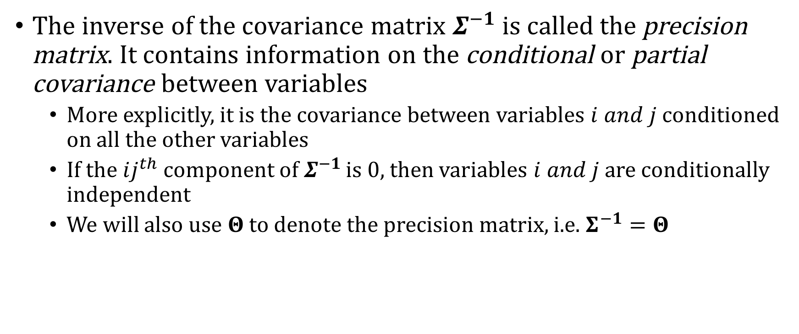
Conditional Probabilities
The inverse of the covariance matrix $Σ^{−1}$ is called the precision matrix. It contains information on the conditional or partial covariance between variables
More explicitly, it is the covariance between variables $i and j$ conditioned on all the other variables
If the $ij^{th}$ component of $Σ^{−1}$ is 0, then variables $i and j$ are conditionally independent
We will also use $Θ$ to denote the precision matrix, i.e. $Σ^{−1}=Θ$
Note: A property of Gaussian distributions is that all conditional distributions are also Gaussian

Slide 8
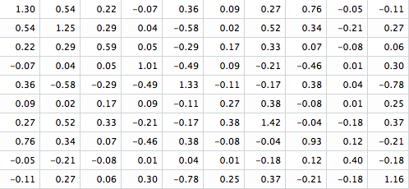
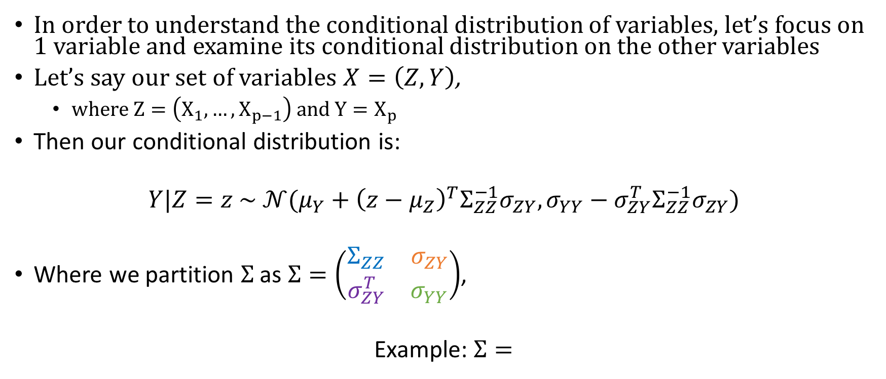
Conditional Distribution of Variables
In order to understand the conditional distribution of variables, let’s focus on 1 variable and examine its conditional distribution on the other variables
Let’s say our set of variables $X=\left(Z,Y\right)$,
$where Z=\left(X_{1},…, X_{p−1}\right) and Y=X_{p}$
Then our conditional distribution is:
$$Y|Z=z \sim 𝒩(μ_{Y}+{\left(z−μ_{Z}\right)}^{T}Σ_{ZZ}^{−1}σ_{ZY}, σ_{YY}−σ_{ZY}^{T}Σ_{ZZ}^{−1}σ_{ZY})$$
Where we partition $Σ$ as $Σ=\left(\begin{matrix}Σ_{ZZ} & σ_{ZY} \\ σ_{ZY}^{T} & σ_{YY}\end{matrix}\right)$,
Example: $Σ=$

Slide 9
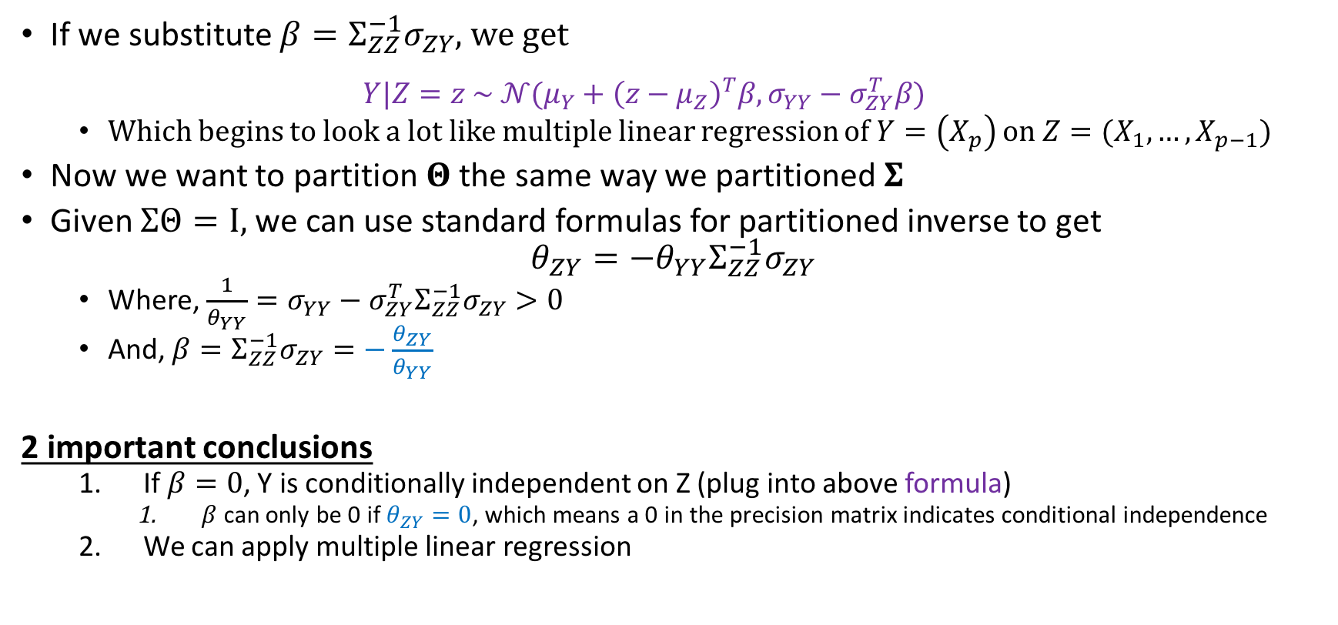
Compared with multiple linear regression
If we substitute $β=Σ_{ZZ}^{−1}σ_{ZY}$, we get
$$Y|Z=z \sim 𝒩(μ_{Y}+{\left(z−μ_{Z}\right)}^{T}β, σ_{YY}−σ_{ZY}^{T}β)$$
Which begins to look a lot like multiple linear regression of $Y=\left(X_{p}\right)$ on $Z=(X_{1},…,X_{p−1})$
Now we want to partition $Θ$ the same way we partitioned$Σ$
Given $ΣΘ=I,$ we can use standard formulas for partitioned inverse to get
$$θ_{ZY}=−θ_{YY}Σ_{ZZ}^{−1}σ_{ZY}$$
Where, $\frac{1}{θ_{YY}}=σ_{YY}−σ_{ZY}^{T}Σ_{ZZ}^{−1}σ_{ZY}>0$
And, $β=Σ_{ZZ}^{−1}σ_{ZY}=−\frac{θ_{ZY}}{θ_{YY}}$
2 important conclusions
If $β=0$, Y is conditionally independent on Z (plug into above formula)
$β$ can only be 0 if $θ_{ZY}=0$, which means a 0 in the precision matrix indicates conditional independence
We can apply multiple linear regression

Slide 10
Gaussian Graphic Models with Known Structure
Must only estimate edge parameters

Slide 11
Estimating Covariance Matrix
We’ve already learned 1 method of estimating the covariance matrix using POET, here we will learn another method of estimation which simultaneously estimates the covariance matrix and the precision matrix
In theory, we could simply use POET to estimate as seen earlier, but then we would need another way to estimate the precision matrix.
Why do we need to estimate?
In situations where the covariance matrix is sparse or has too many variables relative to observations, we need to estimate the covariance matrix
It also turns out that in these situations, we cannot simply take the inverse of the covariance matrix, because it will not accurately represent the true inverse.
Instead, we also need to estimate the inverse of the covariance matrix

Slide 12
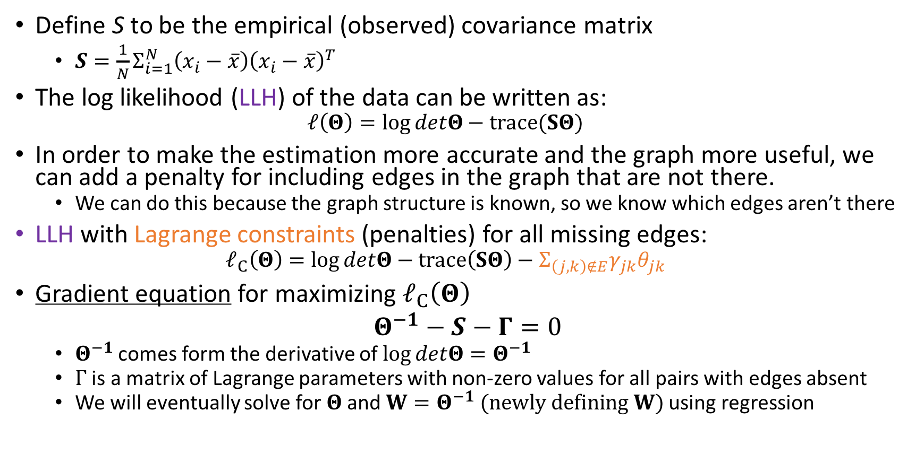
Estimating Covariance Matrix with LLH
Define S to be the empirical (observed) covariance matrix
$S=\frac{1}{N}Σ_{i=1}^{N}\left(x_{i}−\overline{x}\right){\left(x_{i}−\overline{x}\right)}^{T}$
The log likelihood (LLH) of the data can be written as:
$$ℓ\left(Θ\right)=\log{detΘ}−trace(SΘ)$$
In order to make the estimation more accurate and the graph more useful, we can add a penalty for including edges in the graph that are not there.
We can do this because the graph structure is known, so we know which edges aren’t there
LLH with Lagrange constraints (penalties) for all missing edges:
$$ℓ_{C}\left(Θ\right)=\log{detΘ}−trace\left(SΘ\right)−Σ_{\left(j,k\right)∉E}γ_{jk}θ_{jk}$$
Gradient equation for maximizing $ℓ_{C}\left(Θ\right)$
$Θ^{−1}−S−Γ=0$
$Θ^{−1}$ comes form the derivative of $\log{detΘ=Θ^{−1}}$
$Γ$ is a matrix of Lagrange parameters with non-zero values for all pairs with edges absent
We will eventually solve for $Θ$ and ${W=Θ}^{−1} (newly defining W)$using regression
Edge value between variables j and k
Edge penalty

Slide 13





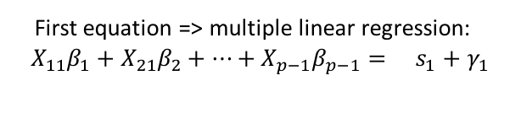
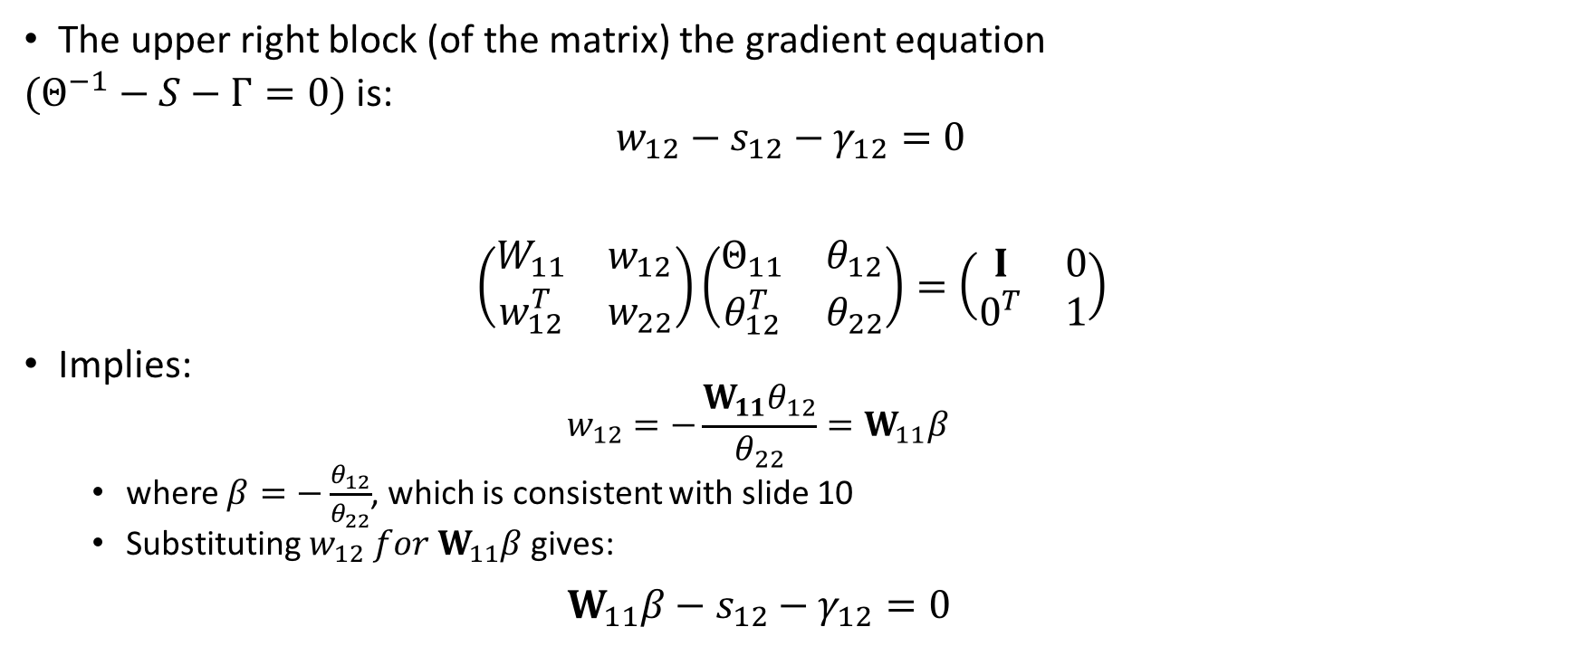
Solving for $W=Θ^{−1}$ with modified regression – Setup 1
Note: Solve W one rxow and column at a time
The upper right block (of the matrix) the gradient equation
$(Θ^{−1}−S−Γ=0)$ is:
$$w_{12}−s_{12}−γ_{12}=0$$
$$\left(\begin{matrix}W_{11} & w_{12} \\ w_{12}^{T} & w_{22}\end{matrix}\right)\left(\begin{matrix}Θ_{11} & θ_{12} \\ θ_{12}^{T} & θ_{22}\end{matrix}\right)=\left(\begin{matrix}I & 0 \\ 0^{T} & 1\end{matrix}\right)$$
Implies:
$$w_{12}=−\frac{W_{11}θ_{12}}{θ_{22}}=W_{11}β$$
where $β=−\frac{θ_{12}}{θ_{22}}$, which is consistent with slide 10
Substituting $w_{12} for W_{11}β$ gives:
$W_{11}β−s_{12}−γ_{12}=0$
Note: S is the empirical covariance matrix. W is the estimated covariance matrix
First equation => multiple linear regression:
$$X_{11}β_{1}+X_{21}β_{2}+…+X_{p−1}β_{p−1}= s_{1}+γ_{1}$$
$$W_{11}$$
$$β$$
$$s_{12}$$
$$γ_{12}$$
*
=
+
(p-1)x1
(p-1)x1
(p-1)x1
(p-1)x(p-1)

Slide 14
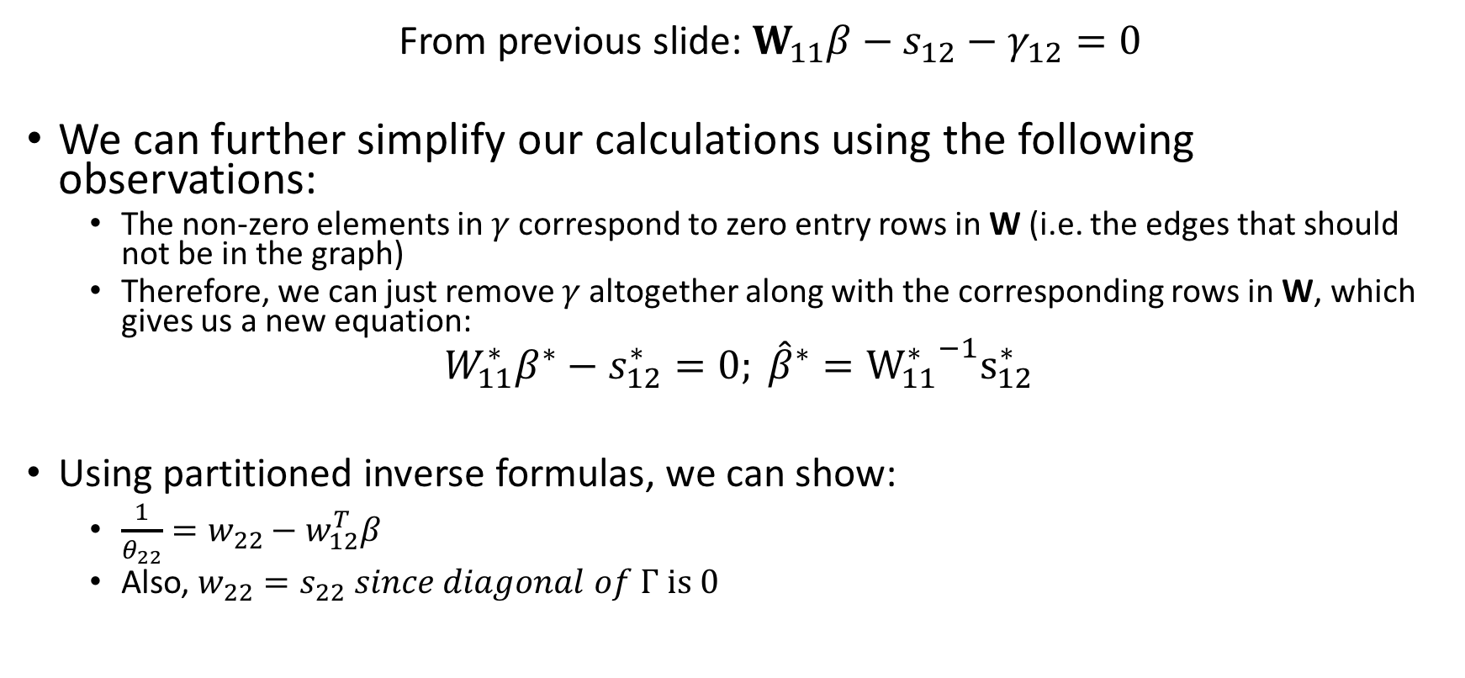
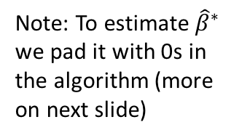

Solving for $W=Θ^{−1}$ with modified regression – Setup 2
From previous slide: $W_{11}β−s_{12}−γ_{12}=0$
We can further simplify our calculations using the following observations:
The non-zero elements in $γ$ correspond to zero entry rows in W (i.e. the edges that should not be in the graph)
Therefore, we can just remove $γ$ altogether along with the corresponding rows in W, which gives us a new equation:
$$W_{11}^{∗}β^{∗}−s_{12}^{∗}=0; {\hat{β}}^{∗}={W_{11}^{∗}}^{−1}s_{12}^{∗}$$
Using partitioned inverse formulas, we can show:
$\frac{1}{θ_{22}}=w_{22}−w_{12}^{T}β$
Also, $w_{22}=s_{22} since diagonal of Γ is 0$
Note: To estimate ${\hat{β}}^{∗}$ we pad it with 0s in the algorithm (more on next slide)

Slide 15





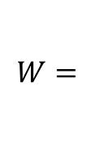
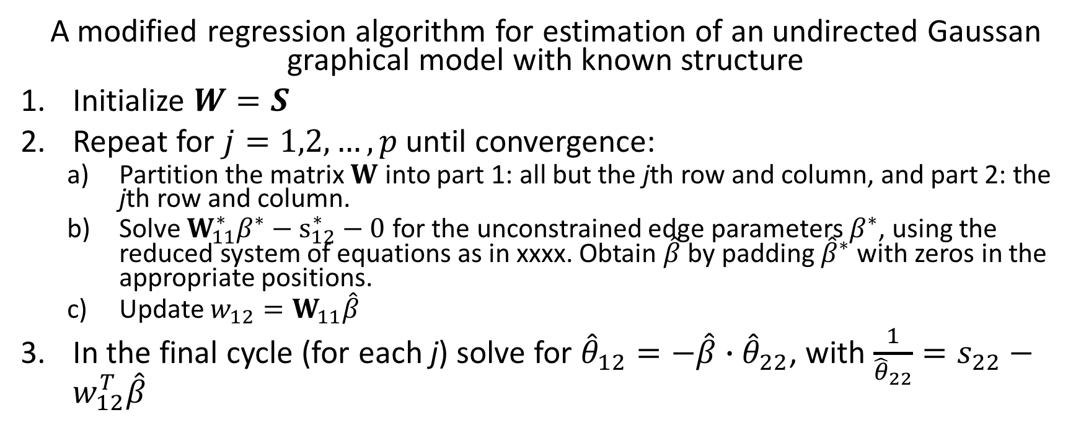
Solving for $W=Θ^{−1}$ with modified regression – Algorithm
A modified regression algorithm for estimation of an undirected Gaussan graphical model with known structure
Initialize $W=S$
Repeat for $j=1,2,…,p$ until convergence:
Partition the matrix $W$ into part 1: all but the jth row and column, and part 2: the jth row and column.
Solve $W_{11}^{∗}β^{∗}−s_{12}^{∗}−0$ for the unconstrained edge parameters $β^{∗}$, using the reduced system of equations as in xxxx. Obtain $\hat{β}$ by padding ${\hat{β}}^{∗}$ with zeros in the appropriate positions.
Update $w_{12}=W_{11}\hat{β}$
In the final cycle (for each j) solve for ${\hat{θ}}_{12}=−\hat{β}{ ∙\hat{θ}}_{22}$, with $\frac{1}{{\hat{θ}}_{22}}=s_{22}−w_{12}^{T}\hat{β}$
$$W_{11}$$
$$s_{12}$$
$$W=$$
$$s_{21}$$
$$s_{22}$$

Slide 16
Code

Slide 17
Gaussian Graphic Models with Unknown Structure
Must estimate both graph structure and edge parameters

Slide 18
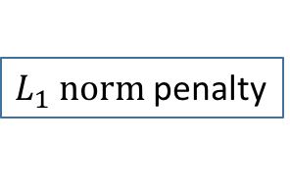
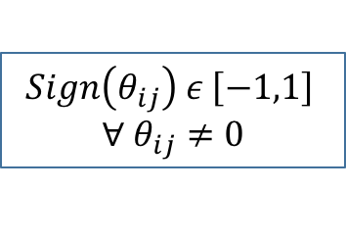
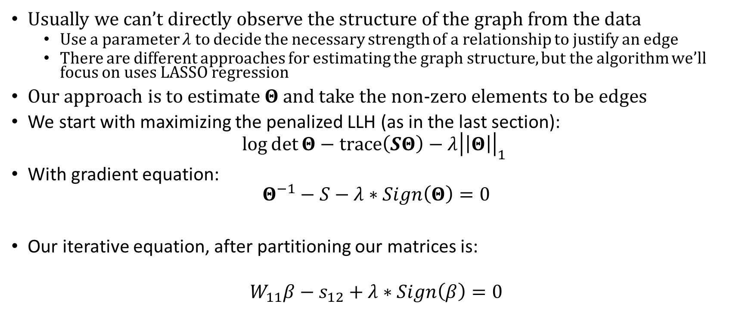
Estimation of Graph Structure
Usually we can’t directly observe the structure of the graph from the data
Use a parameter $λ$ to decide the necessary strength of a relationship to justify an edge
There are different approaches for estimating the graph structure, but the algorithm we’ll focus on uses LASSO regression
Our approach is to estimate $Θ$ and take the non-zero elements to be edges
We start with maximizing the penalized LLH (as in the last section):
$$\log{\det{Θ}−trace\left(SΘ\right)−λ{\left|\left|Θ\right|\right|}_{1}}$$
With gradient equation:
$$Θ^{−1}−S−λ∗Sign\left(Θ\right)=0$$
Our iterative equation, after partitioning our matrices is:
$$W_{11}β−s_{12}+λ∗Sign\left(β\right)=0$$
$L_{1} norm$ penalty
$$Sign\left(θ_{ij}\right) ε \left[−1,1\right]$$
$$∀ θ_{ij}≠0$$
Note: If this equation doesn’t make sense, go back to the last section and check to make sure you understand it. The logic on this slide follows from the last section.

Slide 19





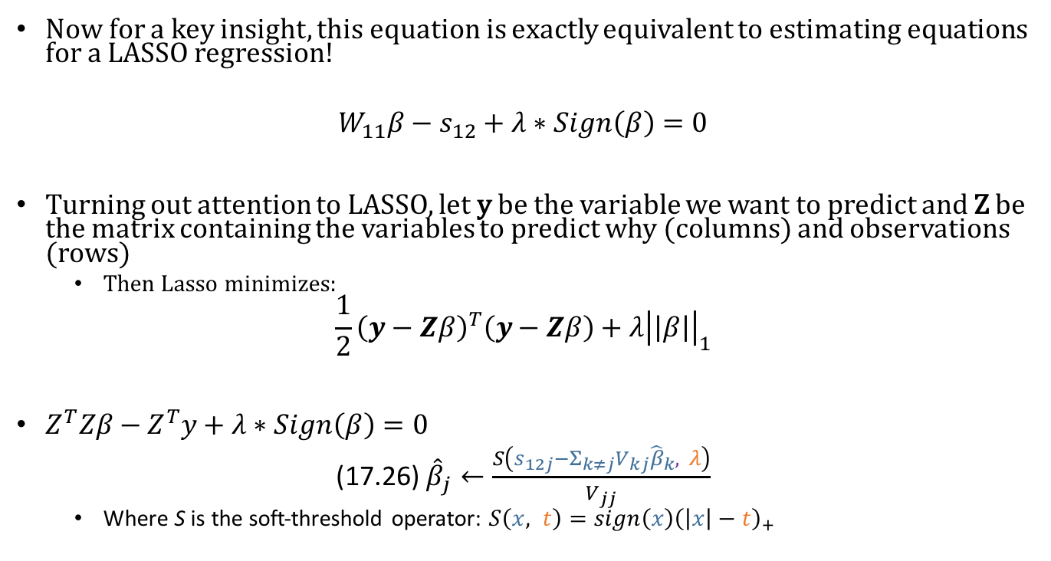
Penalized LLH implies LASSO Regression
Now for a key insight, this equation is exactly equivalent to estimating equations for a LASSO regression!
$$W_{11}β−s_{12}+λ∗Sign\left(β\right)=0$$
Turning out attention to LASSO, let y be the variable we want to predict and Z be the matrix containing the variables to predict why (columns) and observations (rows)
Then Lasso minimizes:
$$\frac{1}{2}{\left(y−Zβ\right)}^{T}\left(y−Zβ\right)+λ{\left|\left|β\right|\right|}_{1}$$
$Z^{T}Zβ−Z^{T}y+λ∗Sign\left(β\right)=0$
(17.26) ${\hat{β}}_{j}←\frac{S\left(s_{12j}−Σ_{k≠j}V_{kj}{\hat{β}}_{k}, λ\right)}{V_{jj}}$
Where S is the soft-threshold operator: $S\left(x, t\right)=sign\left(x\right){\left(\left|x\right|−t\right)}_{+}$
First equation:
$$y_{1}=z_{11}β_{1}+z_{12}β_{2}+…+z_{1p}β_{p}$$
$$y$$
$$Z_{1}β_{1}$$
$$Z_{2}β_{2}$$
$$Z_{2}β_{2}$$
=
+
+ .. +

Slide 20
Do we need to teach Ridge and Lasso regression?

Slide 21
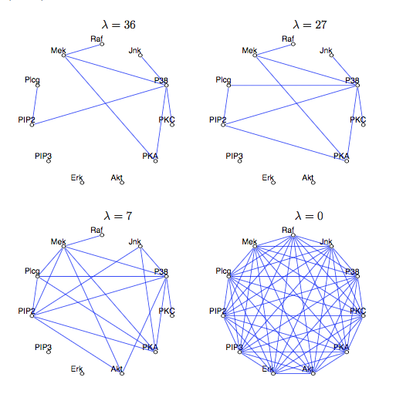

Graph Structures with Different $λ$

Slide 22
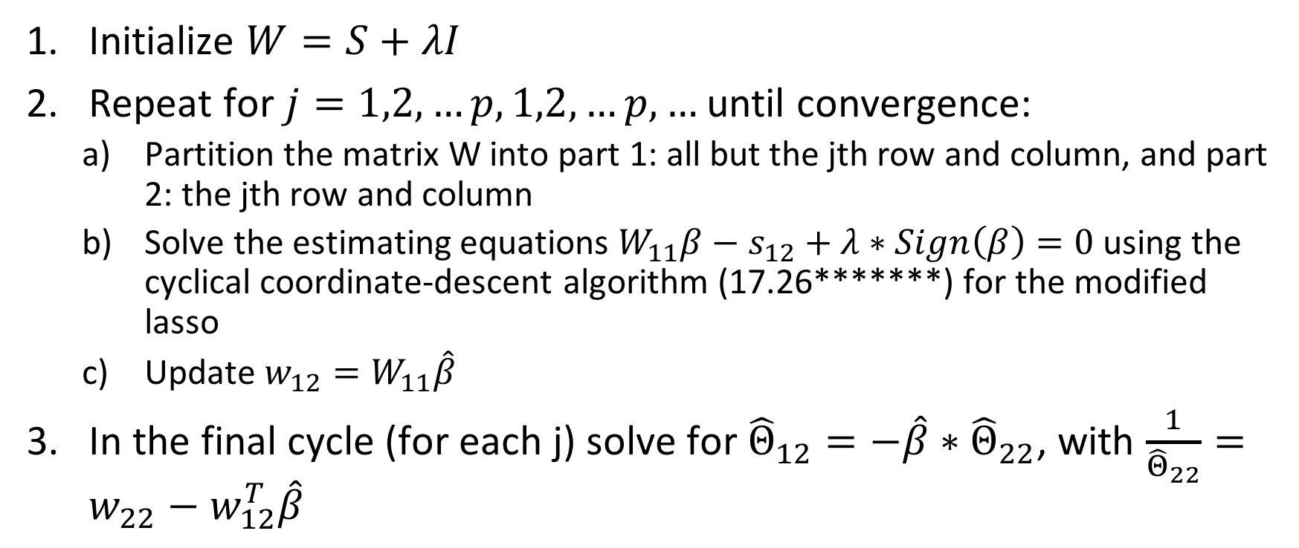
“Graphical Lasso” Algorithm
Initialize $W=S+λI$
Repeat for $j=1,2,…p,1,2,…p,…$ until convergence:
Partition the matrix W into part 1: all but the jth row and column, and part 2: the jth row and column
Solve the estimating equations $W_{11}β−s_{12}+λ∗Sign\left(β\right)=0$ using the cyclical coordinate-descent algorithm (17.26*******) for the modified lasso
Update $w_{12}=W_{11}\hat{β}$
In the final cycle (for each j) solve for ${\hat{Θ}}_{12}=−\hat{β}∗{\hat{Θ}}_{22}$, with $\frac{1}{{\hat{Θ}}_{22}}=w_{22}−w_{12}^{T}\hat{β}$
Very fast!

Slide 23
About paper

Slide 24
Ising Models (aka “Boltzmann machines”) – Discrete Variables

Slide 25
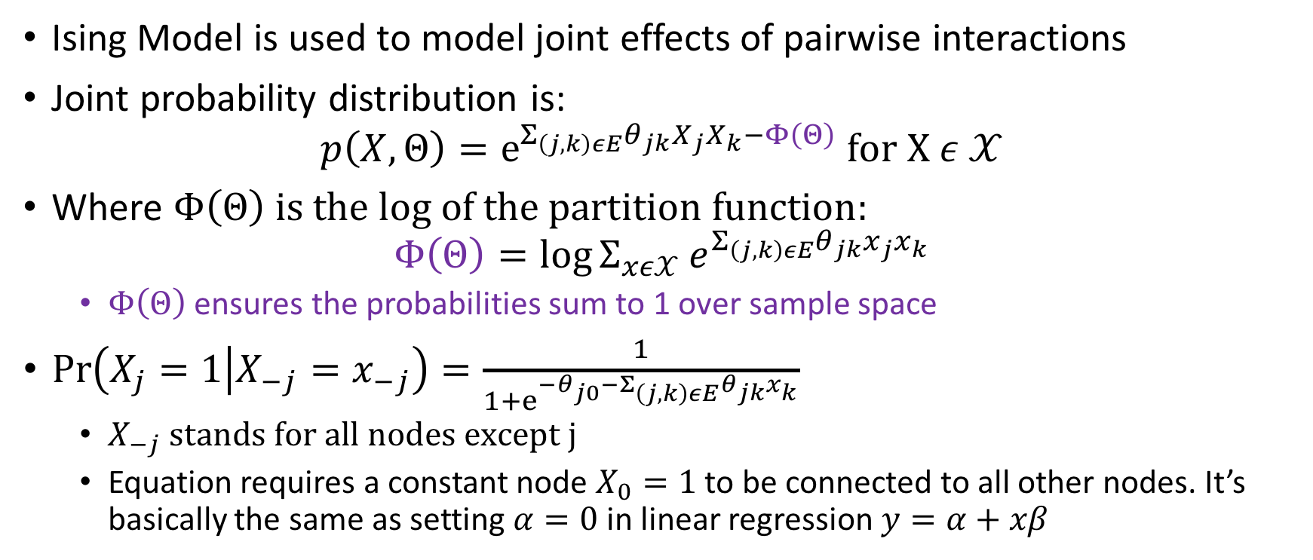
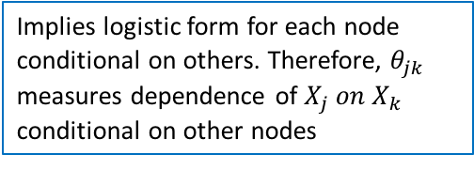
Ising Model Setup
Ising Model is used to model joint effects of pairwise interactions
Joint probability distribution is:
$$p\left(X,Θ\right)=e^{Σ_{\left(j,k\right)εE}θ_{jk}X_{j}X_{k}−Φ\left(Θ\right)} for X ε 𝒳$$
Where $Φ\left(Θ\right) is the log of the partition function:$
$$Φ\left(Θ\right)=\log{Σ_{xε𝒳}}e^{Σ_{\left(j,k\right)εE}θ_{jk}x_{j}x_{k}}$$
$Φ\left(Θ\right)$ ensures the probabilities sum to 1 over sample space
$\operatorname{Pr}\left(X_{j}=1 | X_{−j}=x_{−j}\right)=\frac{1}{1+e^{−θ_{j0}−Σ_{\left(j,k\right)εE}θ_{jk}x_{k}}}$
$X_{−j} stands for all nodes except j$
Equation requires a constant node $X_{0}=1$ to be connected to all other nodes. It’s basically the same as setting $α=0$ in linear regression $y=α+xβ$
Implies logistic form for each node conditional on others. Therefore, $θ_{jk}$ measures dependence of $X_{j} on X_{k}$ conditional on other nodes

Slide 26
Ising Models with Known Structure
Must only estimate edge parameters

Slide 27
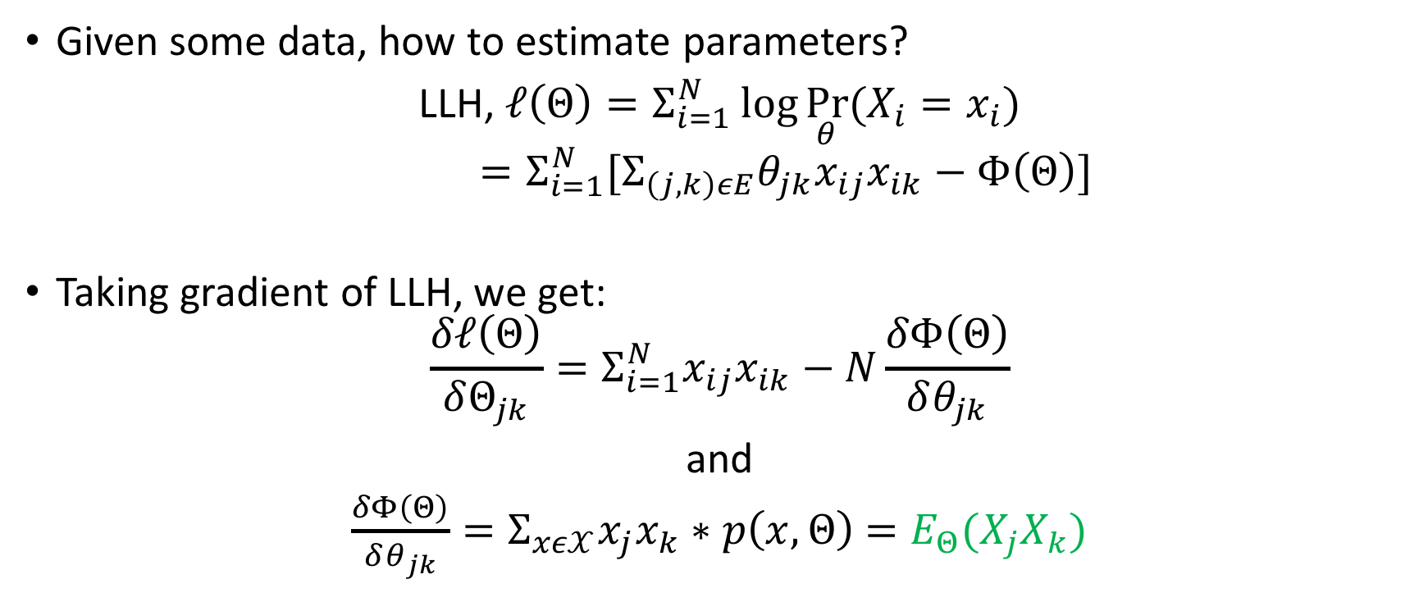
Estimation of parameters
Given some data, how to estimate parameters?
LLH, $ℓ\left(Θ\right)=Σ_{i=1}^{N}\log{\underset{θ}{Pr}{(X_{i}=x_{i})}}$
$=Σ_{i=1}^{N}[Σ_{\left(j,k\right)εE}θ_{jk}x_{ij}x_{ik}−Φ\left(Θ\right)]$
Taking gradient of LLH, we get:
$$\frac{δℓ\left(Θ\right)}{δΘ_{jk}}=Σ_{i=1}^{N}x_{ij}x_{ik}−N\frac{δΦ\left(Θ\right)}{δθ_{jk}}$$
and
$\frac{δΦ\left(Θ\right)}{δθ_{jk}}=Σ_{xε𝒳}x_{j}x_{k}∗p\left(x,Θ\right)$ $=E_{Θ}(X_{j}X_{k})$
This comes from joint probability distribution formula

Slide 28
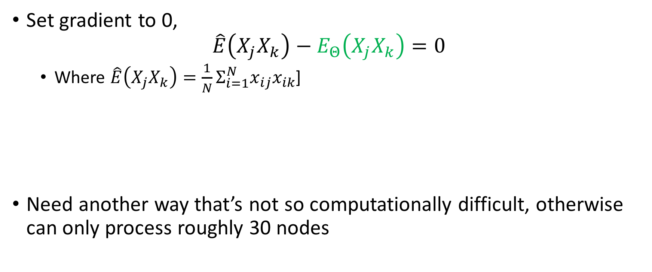
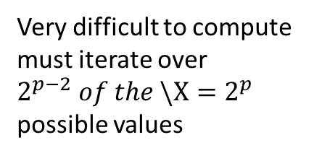
Estimation of parameters
Set gradient to 0,
$$\hat{E}\left(X_{j}X_{k}\right)−E_{Θ}\left(X_{j}X_{k}\right)=0$$
Where $\hat{E}\left(X_{j}X_{k}\right)=\frac{1}{N}Σ_{i=1}^{N}x_{ij}x_{ik}$]
Need another way that’s not so computationally difficult, otherwise can only process roughly 30 nodes
Very difficult to compute must iterate over $2^{p−2} of the \backslash X=2^{p}$ possible values

Slide 29
Ising Models with Unknown Structure
Must estimate both graph structure and edge parameters

Slide 30
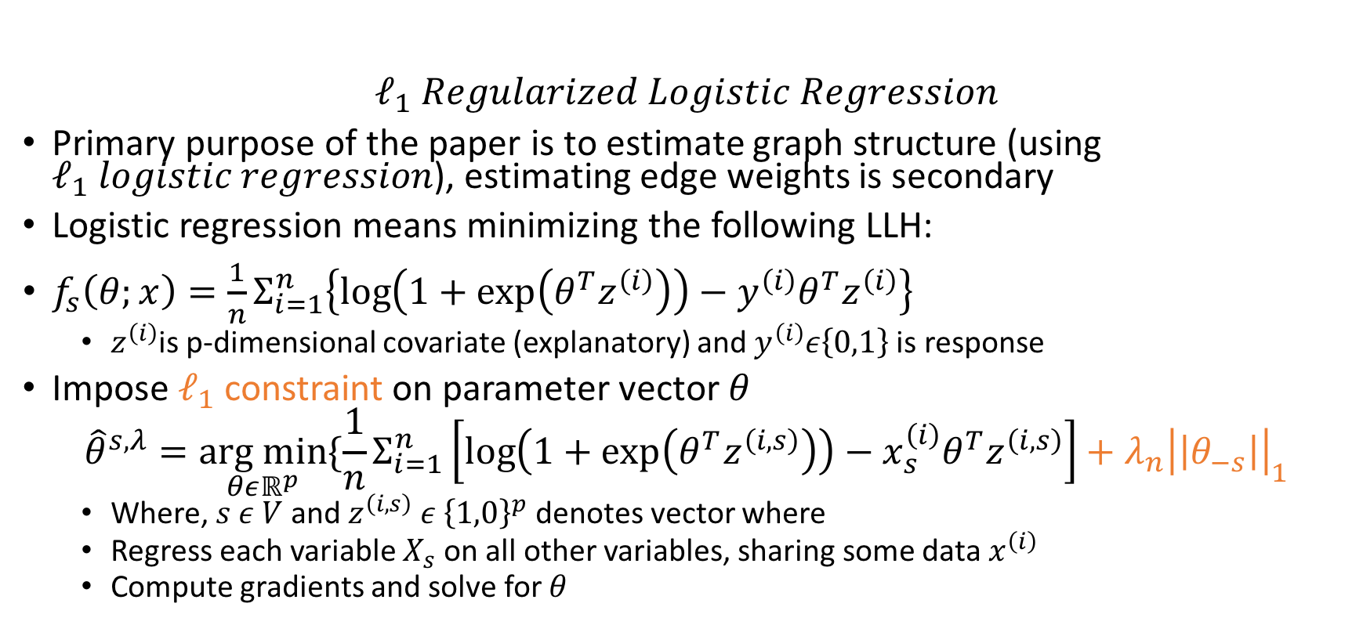
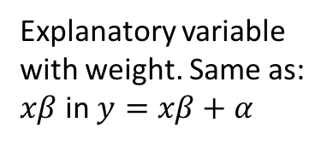
Wainwright, Ravikumar, Lafferty
$$ℓ_{1} Regularized Logistic Regression$$
Primary purpose of the paper is to estimate graph structure (using $ℓ_{1} logistic regression$), estimating edge weights is secondary
Logistic regression means minimizing the following LLH:
$f_{s}\left(θ;x\right)=\frac{1}{n}Σ_{i=1}^{n}\left\{\log\left(1+\exp\left(θ^{T}z^{\left(i\right)}\right)\right)−y^{\left(i\right)}θ^{T}z^{\left(i\right)}\right\}$
$z^{\left(i\right)}$is p-dimensional covariate (explanatory) and $y^{\left(i\right)}ε\left\{0,1\right\}$ is response
Impose $ℓ_{1}$ constraint on parameter vector $θ$
$${\hat{θ}}^{s,λ}=\underset{θεℝ^{p}}{arg min}{\{\frac{1}{n}Σ_{i=1}^{n}\left[\log\left(1+\exp\left(θ^{T}z^{\left(i,s\right)}\right)\right)−x_{s}^{\left(i\right)}θ^{T}z^{\left(i,s\right)}\right]+λ_{n}{\left|\left|θ_{−s}\right|\right|}_{1}}$$
Where, $s ε V$ and $z^{\left(i,s\right)} ε {\left\{1,0\right\}}^{p}$ denotes vector where
Regress each variable $X_{s}$ on all other variables, sharing some data $x^{\left(i\right)}$
Compute gradients and solve for $θ$
Explanatory variable with weight. Same as: $xβ$ in $y=xβ+α$

